Slide 1
Travel planning using the best possible route and maximising the visits to the sites using Time dependent Orienteering Problem
Mohd Sadiqe Raheem Shaikh(2021AIM1012)
M Pavan Naik(2021AIM1011)

Slide 2

Introduction
Our problem statement focuses on providing the user(tourists) with optimal route which contains maximum scenic views, while not exceeding a cost budget (e.g., total travel time).

Slide 3
Timeline
1st week
3rd week
2nd week
4th week
Literature Review
Identifying limitations and improvements
Setting Up |  |  |  | Implementation
Code building and data integration
Preparing demo

Slide 4

Proposed Work
We propose to use the following heuristic to calculate the most optimal path for travelling and visiting the place
time-dependent spatial data for the road networks
time-dependent heuristic for the locations

Slide 5
Heuristic and assumptions
Bidirectional A*
Cost function = g(x) + h(x)
g(x) = Dynamic travel time on an edge
h(x) = Estimated time from next node to destination
●h_{time}(x)=Manhattan distance to dest / max speed limit in that region
○Will always be an under estimator and thereby admissible
●Edge weight distributions
○Individual distribution of travel time for each edge

Slide 6
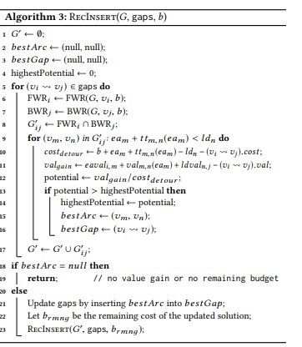
We solve the path finding problem using Bidirectional A* algorithm

Slide 7
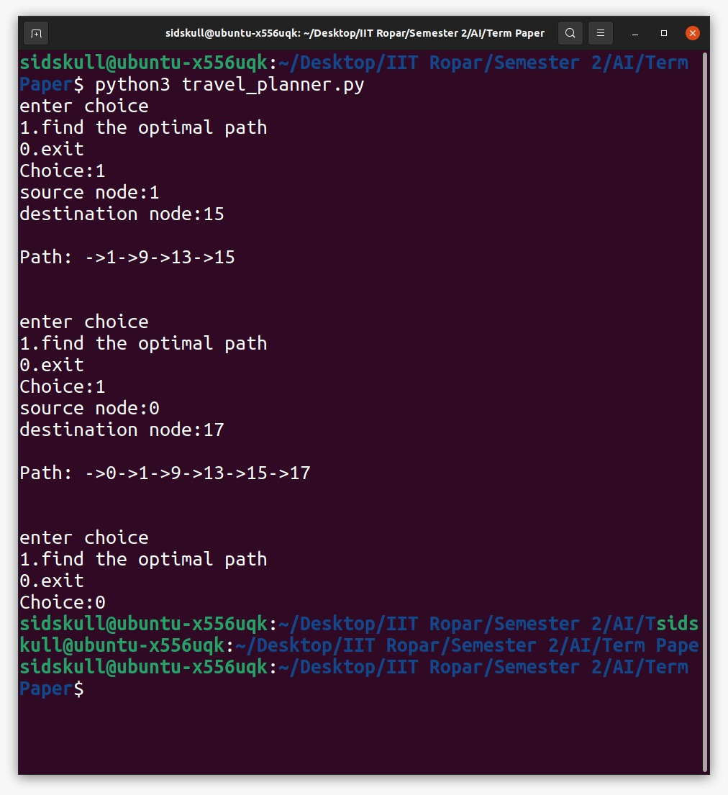
Observations and Results
We were able to provide the user with the optimal path which includes best scenic views and locations within less amount of time and cost.

Slide 8
References
Enjoy the most beautiful scene now: a memetic algorithm to solve two-fold time-dependent arc orienteering problem
Chao CHEN, Liping GAO1, Xuefeng XIE,, Zhu WANG2
Scenic Routes Now: Eﬀiciently Solving the Time-Dependent Arc Orienteering Problem
Ying Lu†⋆, Gregor Jossé‡⋆, Tobias Emrich‡ , Ugur Demiryurek†, Matthias Renz# , Cyrus Shahabi† , Matthias Schubert‡
An extension of the arc orienteering problem and its application to cycle trip planning
C. Verbeeck a,⇑, P. Vansteenwegen b, E.-H. Aghezzaf a

Slide 9
THANK YOU

